Slide 1
Raw Western Blots & Gels

Slide 2
Figure 1E
Western blots – SKMEL5 treated with DMSO or corin (24h, 2.5uM). Probed for LSD1, RCOR1, U2AF2, SRSF1, GAPDH

Slide 3
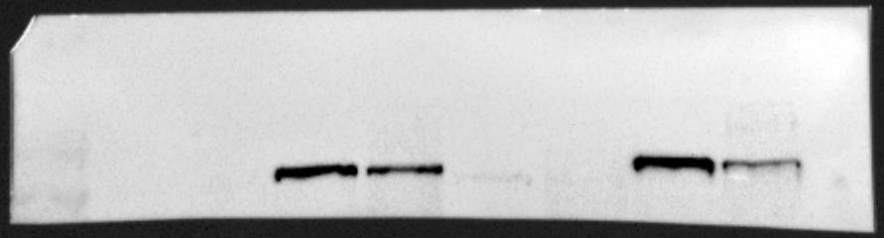
Replicate 1: LSD1

Slide 4
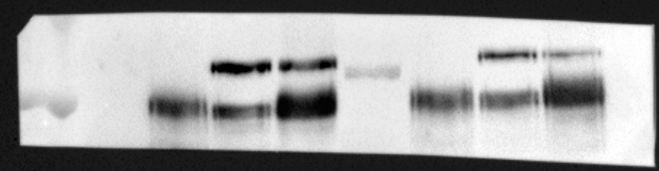
Replicate 1: RCOR1

Slide 5
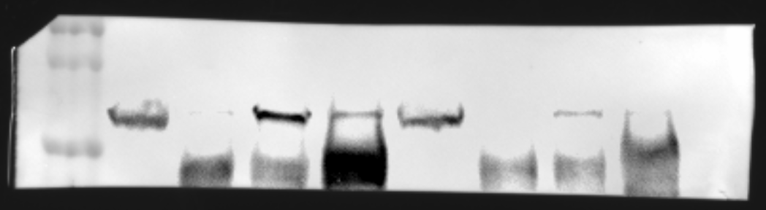
Replicate 1: U2AF2

Slide 6
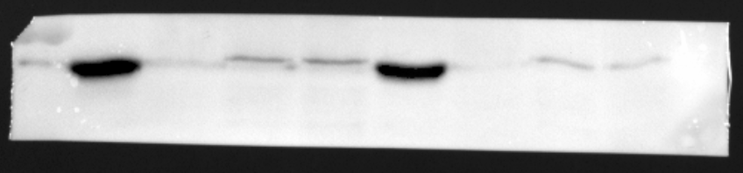
Replicate 1: SRSF1

Slide 7
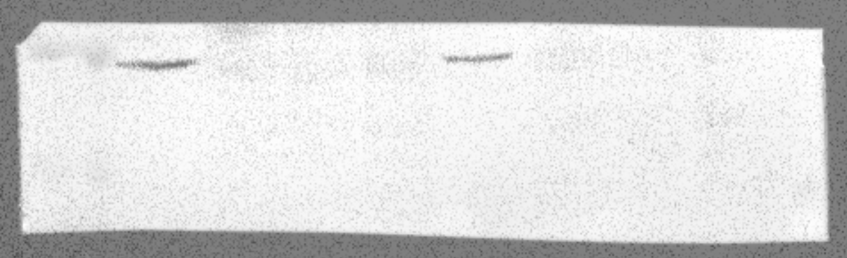
Replicate 1: GAPDH

Slide 8
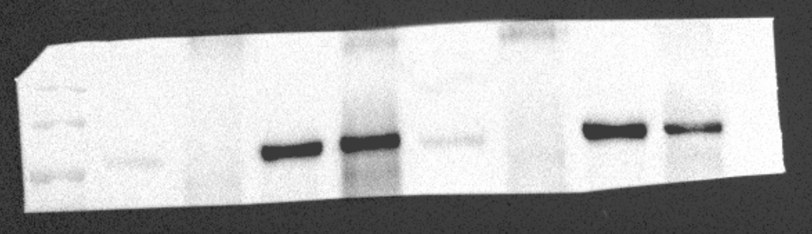
Replicate 2: LSD1

Slide 9
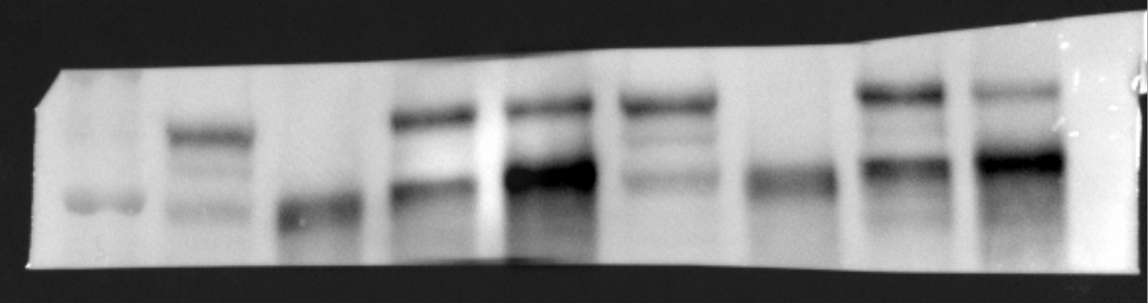
Replicate 2: RCOR1

Slide 10
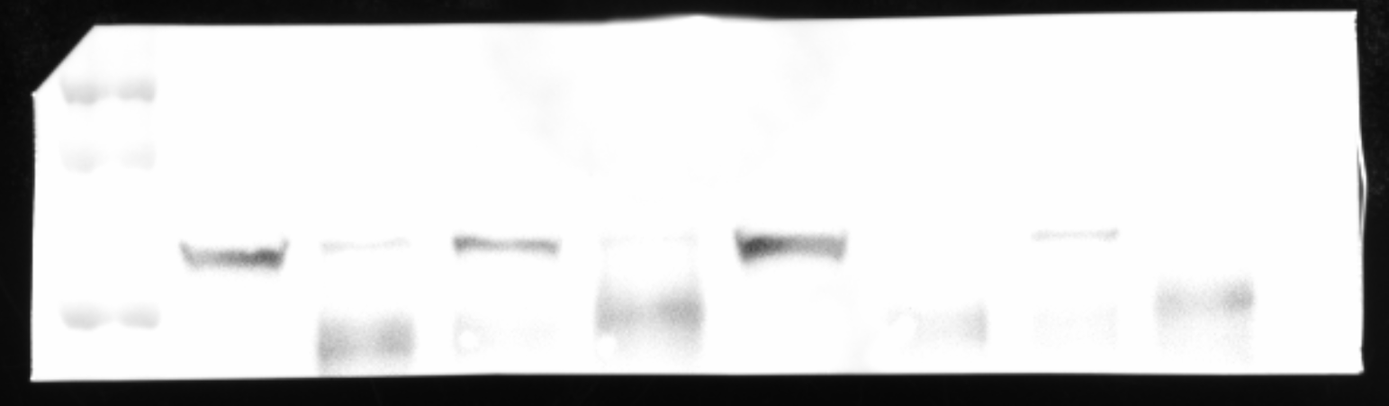
Replicate 2: U2AF2

Slide 11
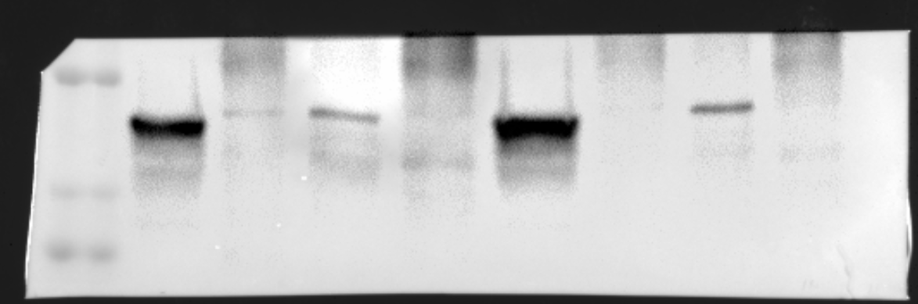
Replicate 2: SRSF1

Slide 12
Figure 1F
Coomassie staining– Purified proteins

Slide 13
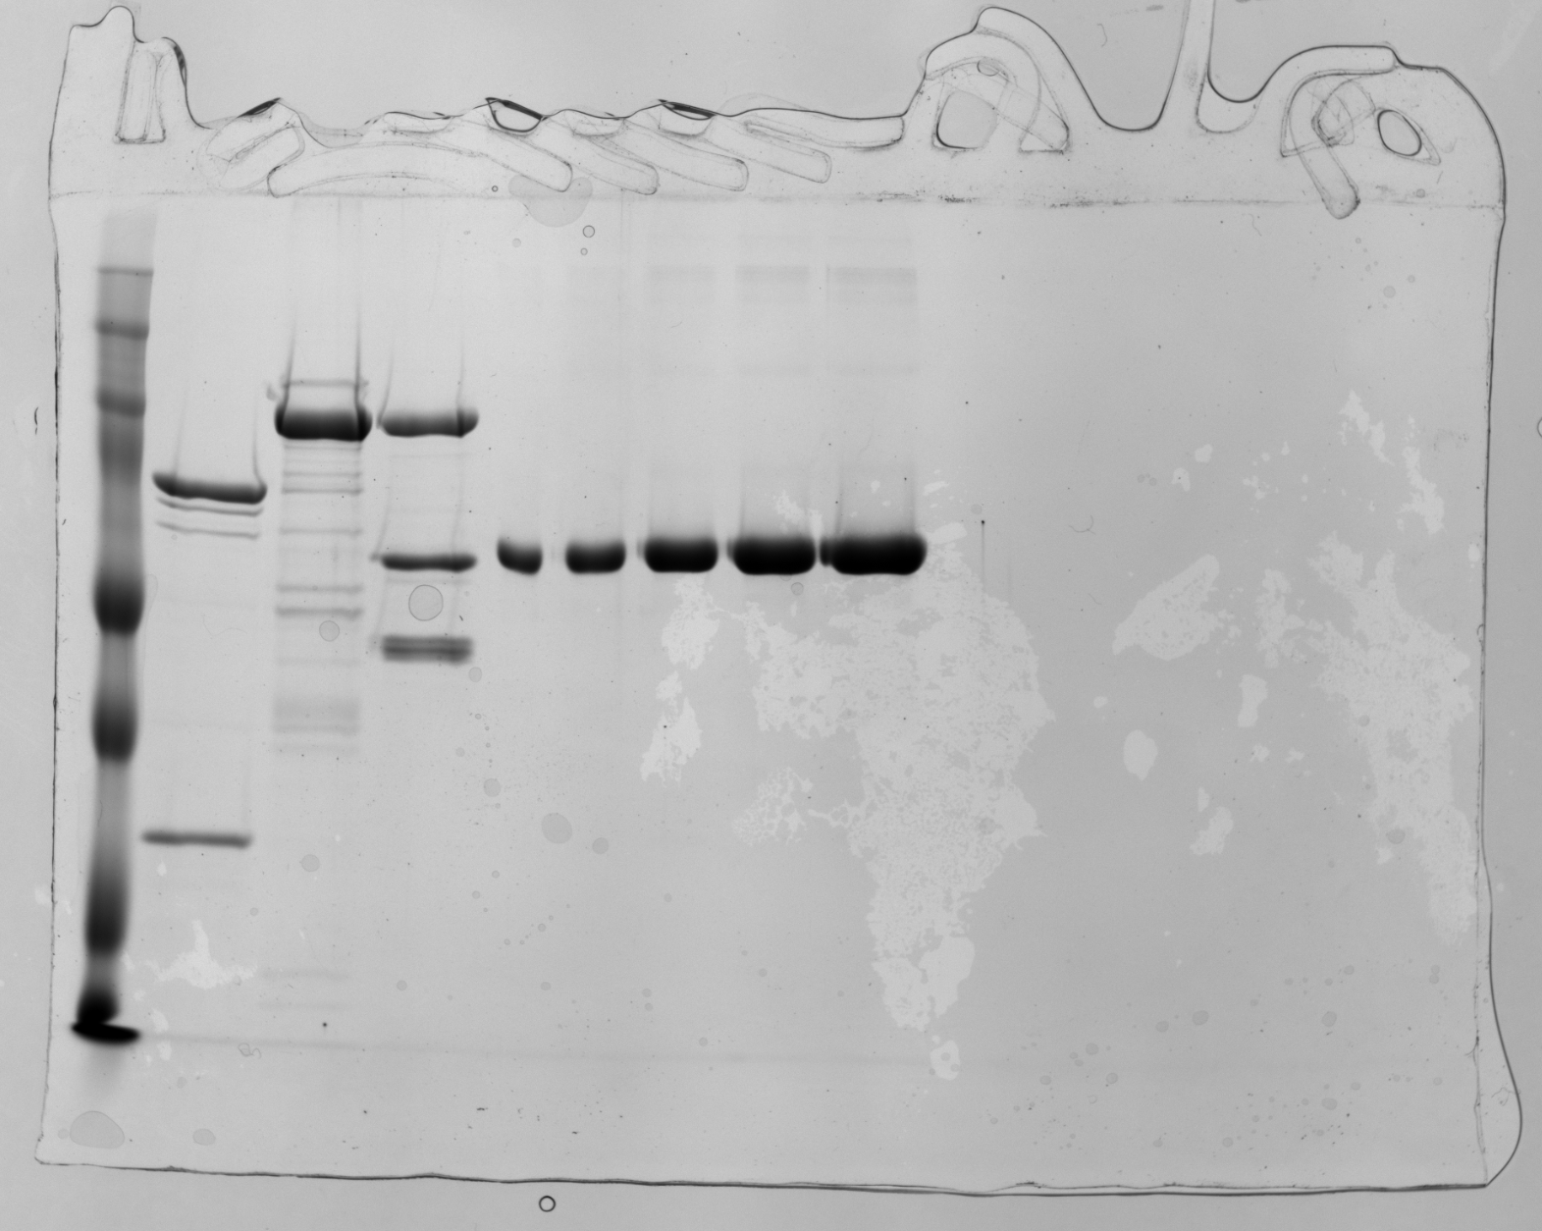
1. Full-length LSD1, LSD1-HDAC1-RCOR1 complex

Slide 14
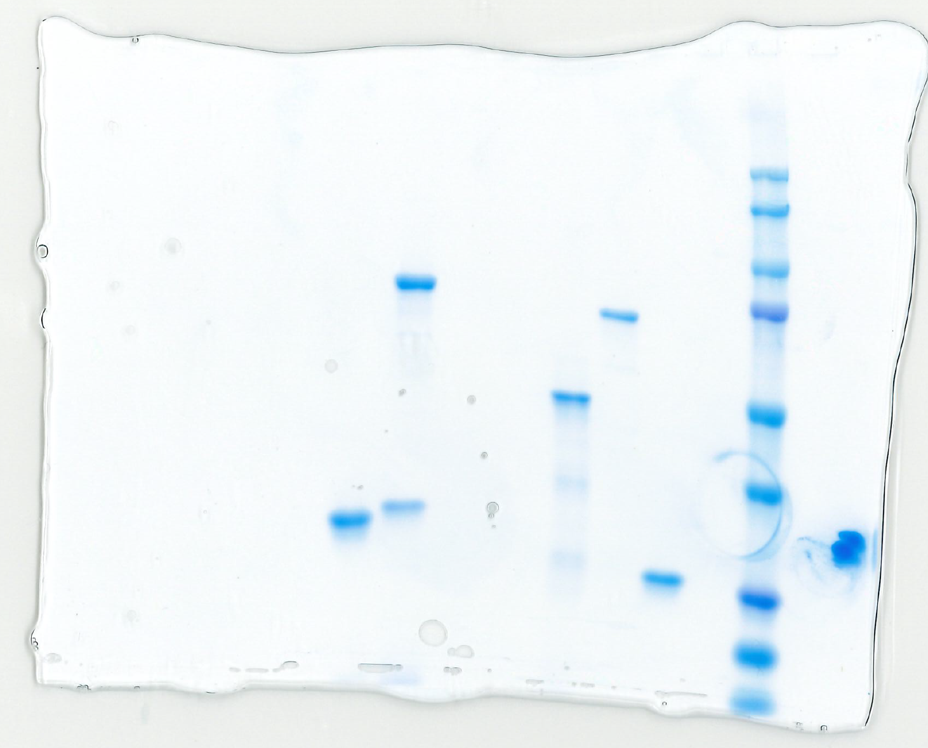
2. GST, GST-U2AF2 85-471, GST-SRSF1 3. His-LSD1 171-852/His-RCOR1 289-485, His-U2AF2 241-471

Slide 15
Figure 1G
Western blots – WT and U2AF2-V5 O/E SKMEL5 treated with DMSO or corin (24h, 2.5uM). Probed for LSD1, RCOR1, U2AF2, SRSF1, GAPDH

Slide 16
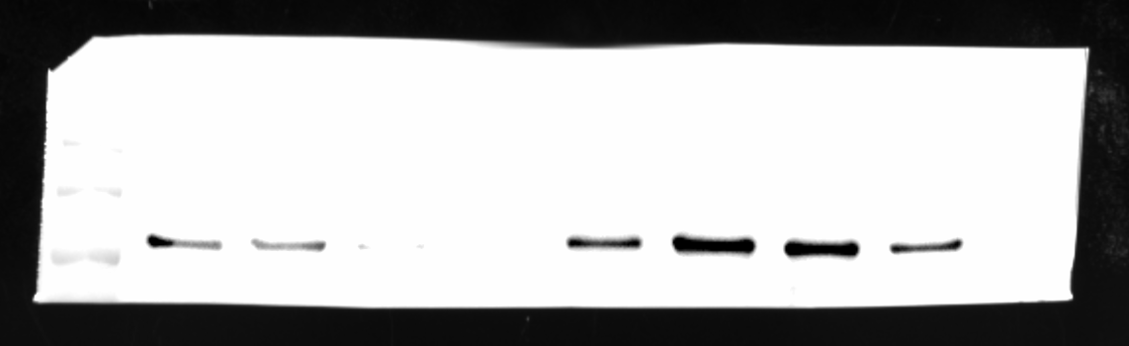
Replicate 1: LSD1

Slide 17
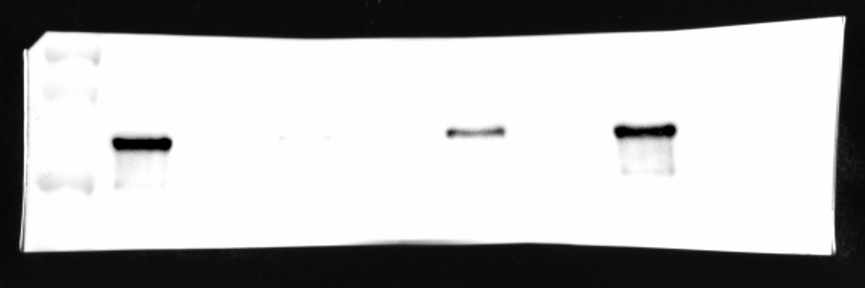
Replicate 1: HDAC1

Slide 18
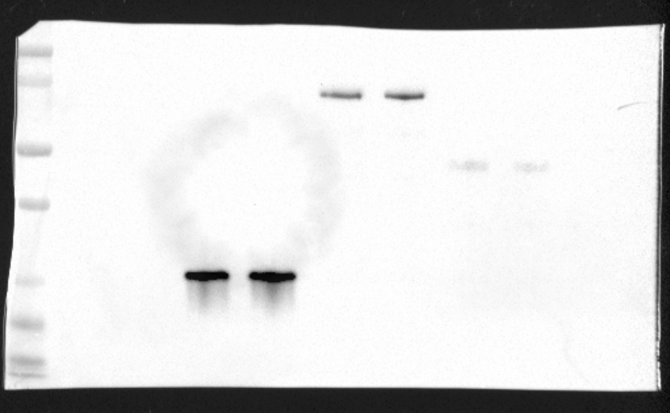
Replicate 1: GST

Slide 19
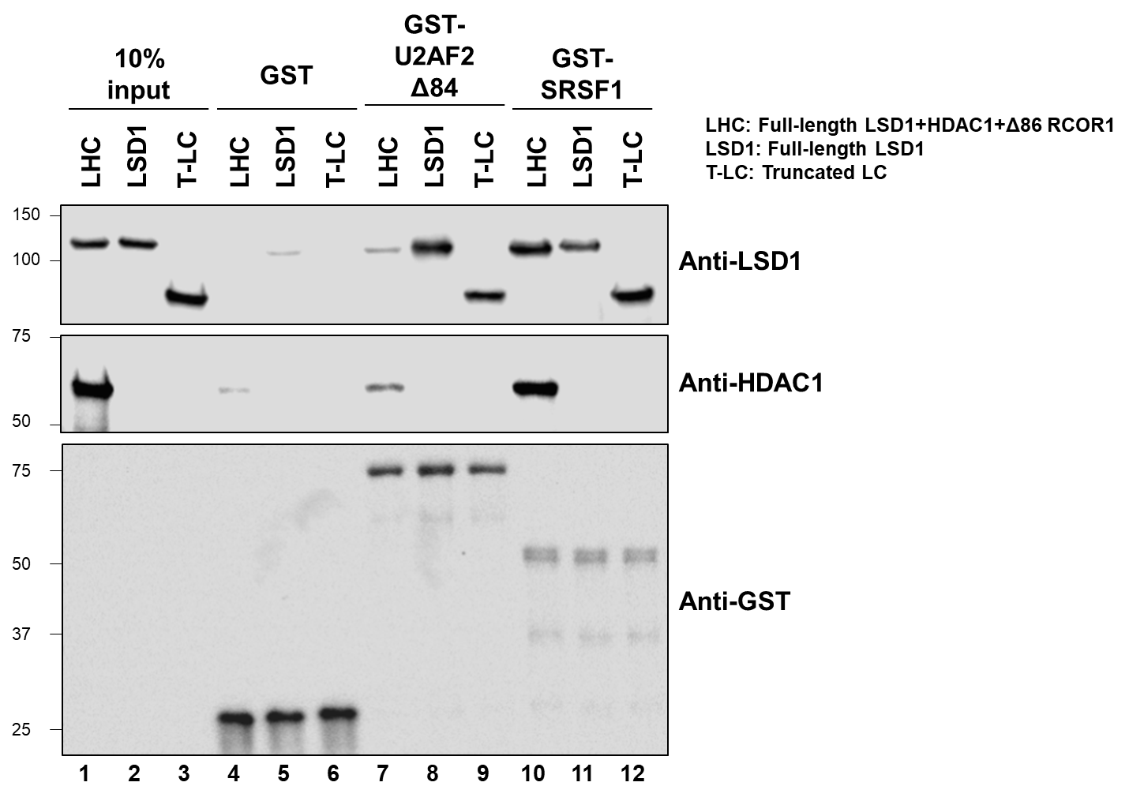
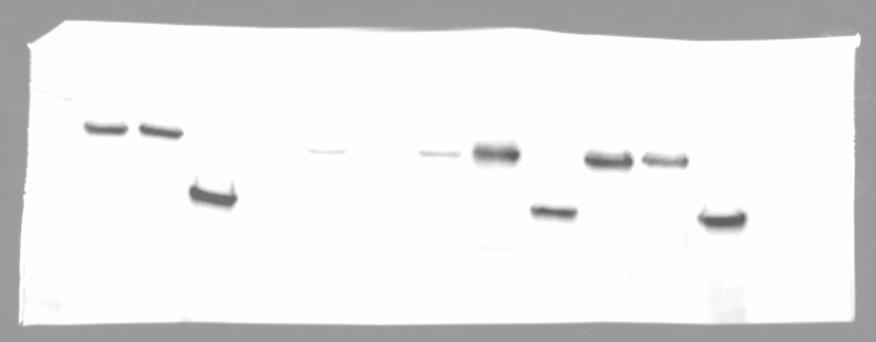
Replicate 2: LSD1
In addition to LHS and LSD1, TR-LC is also included in this experiment

Slide 20
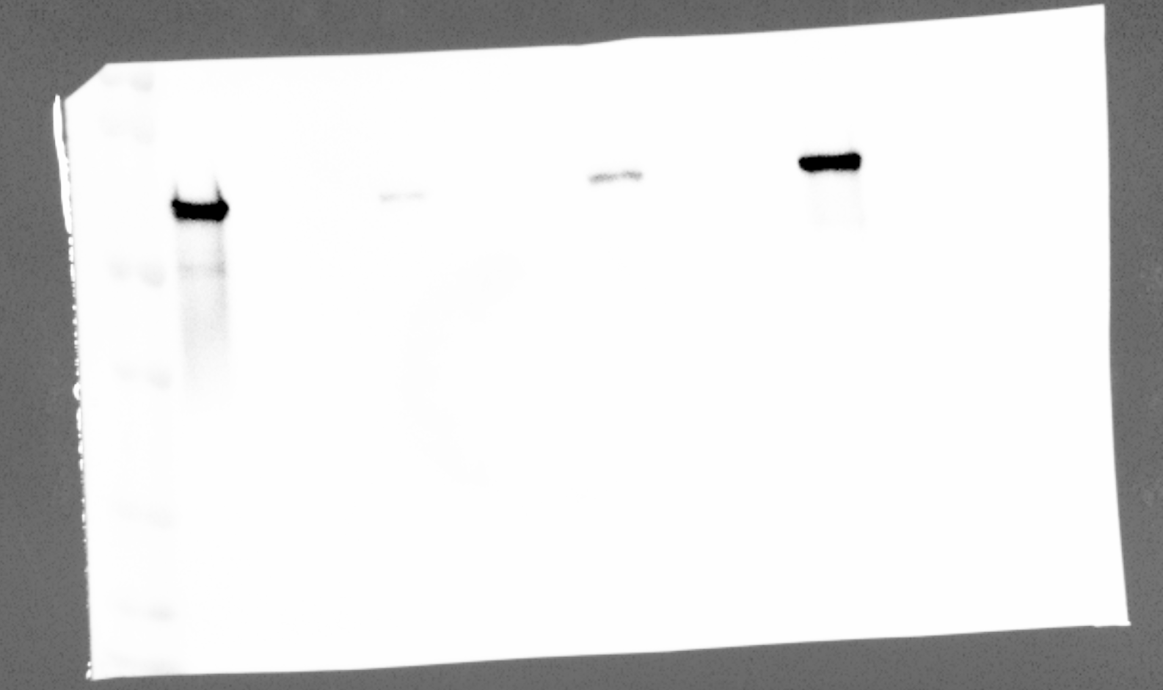
Replicate 2: HDAC1
In addition to LHS and LSD1, TR-LC is also included in this experiment

Slide 21
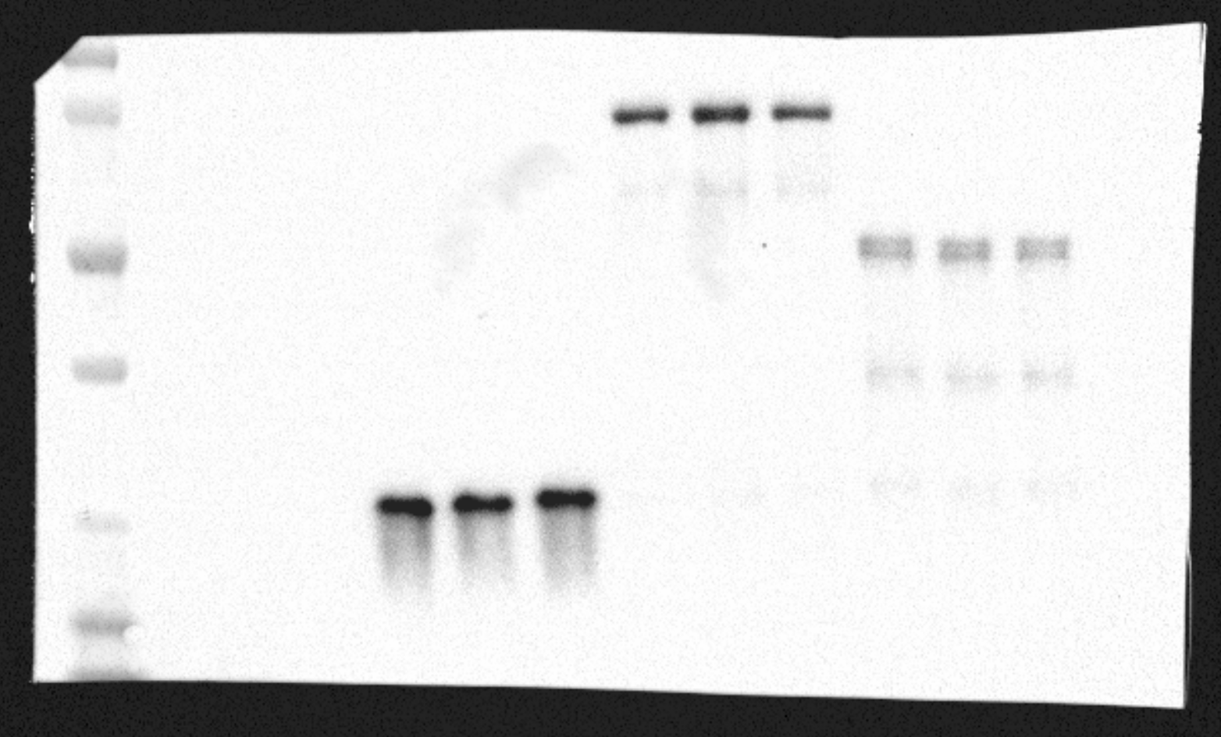
Replicate 2: GST
In addition to LHS and LSD1, TR-LC is also included in this experiment

Slide 22
Figure 1H
Coomassie staining-Size exclusion of LSD1-RCOR1-U2AF2 for Cryo-EM sample preparation

Slide 23
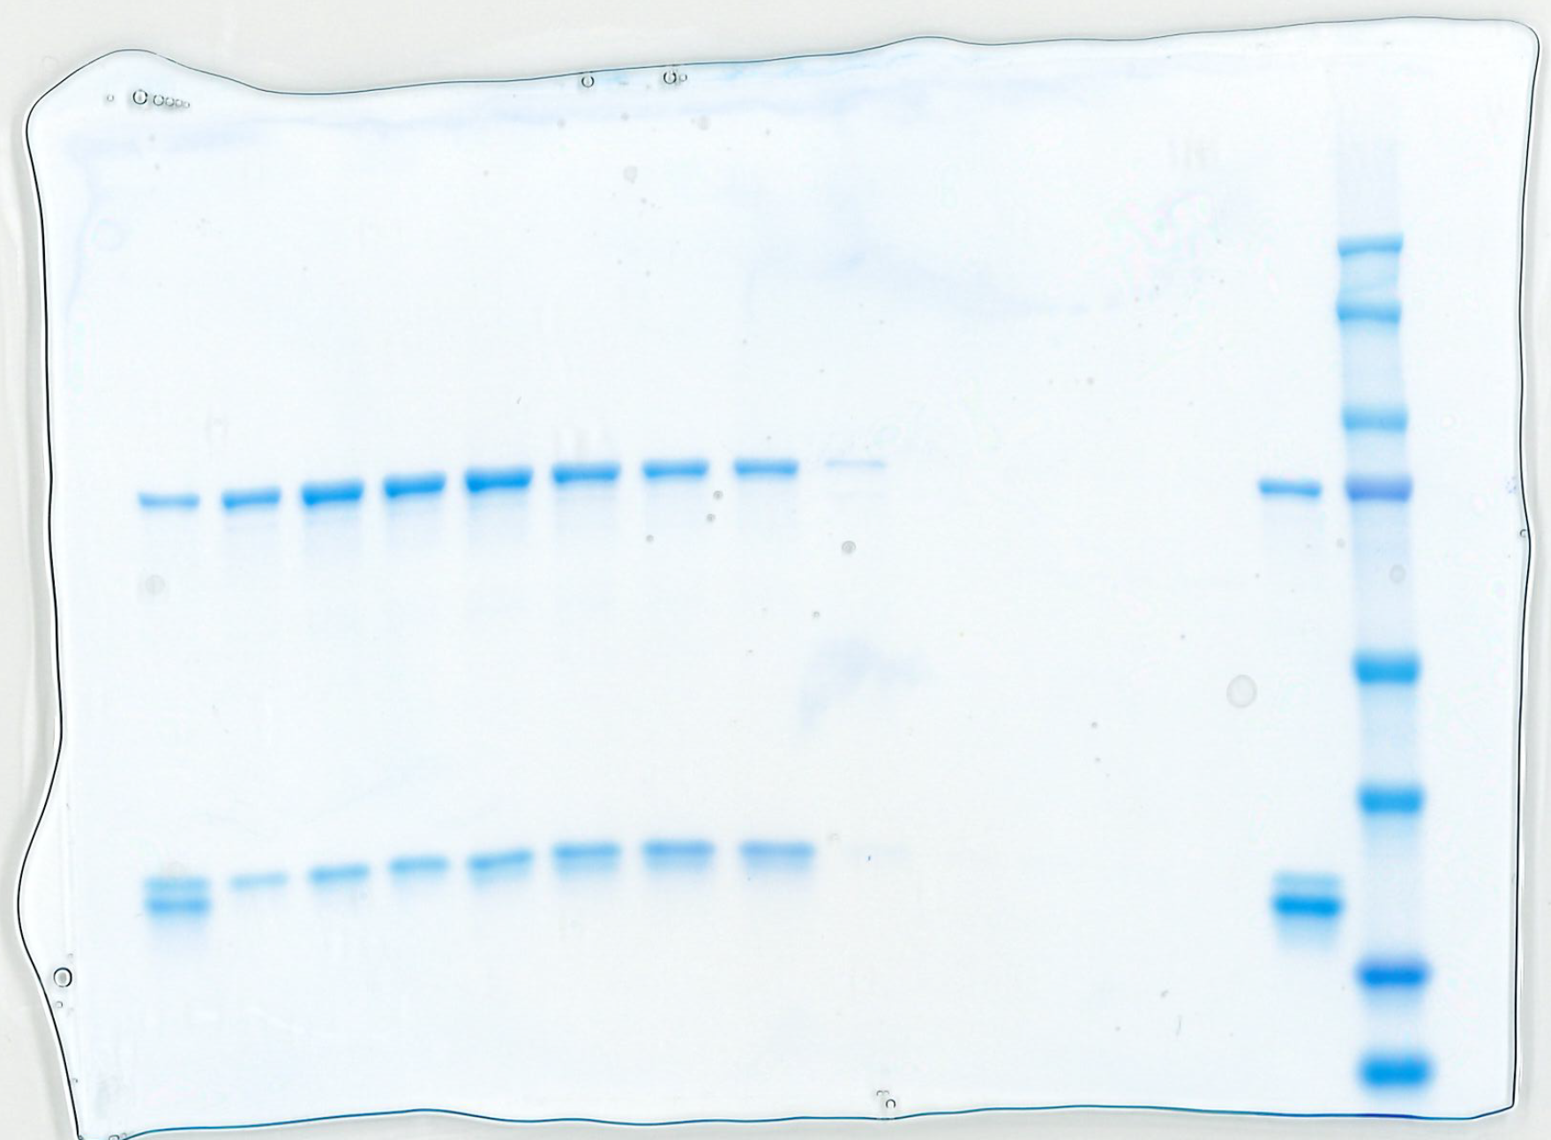
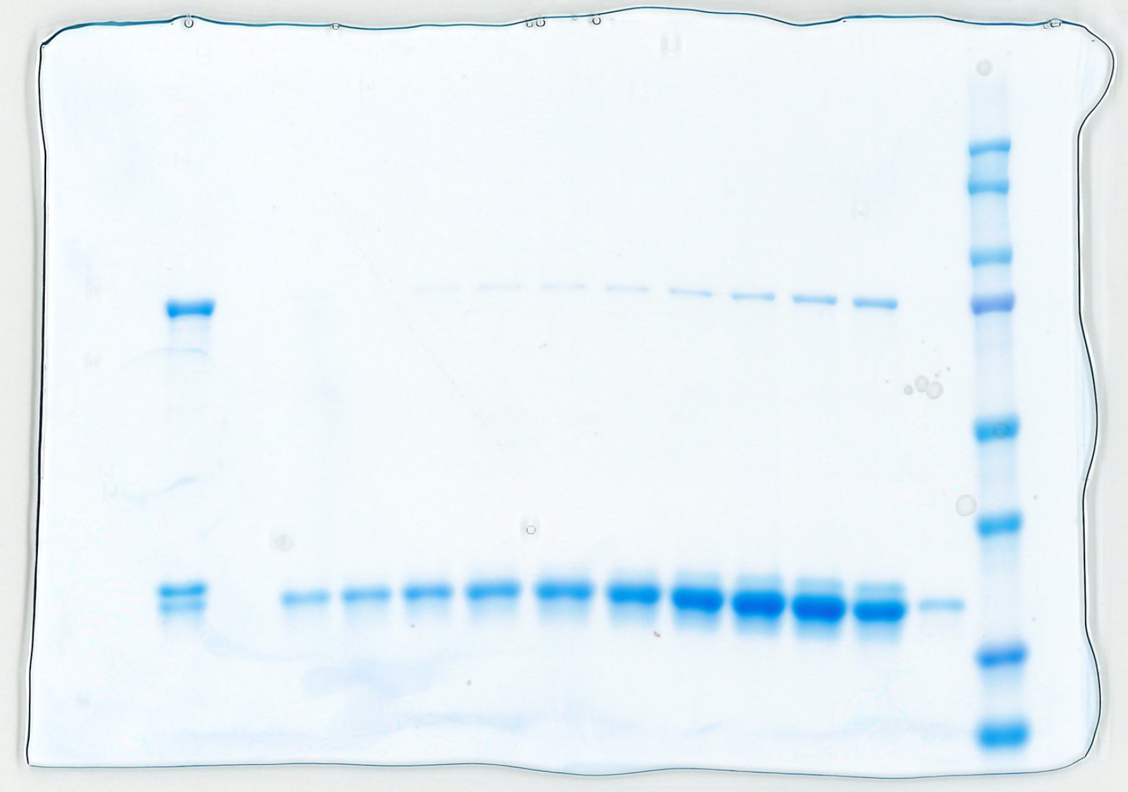

Slide 24
Figure 2D, Extended Figure 2B
Western blots – 6 cell lines treated with DMSO or corin (24h, 2.5uM). Probed for U2AF2, ALYREF, RBMX, and GAPDH

Slide 25
Replicate 1: ALYREF

Slide 26
Replicate 1: U2AF2

Slide 27
Replicate 1: RBMX

Slide 28
Replicate 1: GAPDH

Slide 29
Replicate 2: ALYREF

Slide 30
Replicate 2: U2AF2

Slide 31
Replicate 2: RBMX

Slide 32
Replicate 2: GAPDH

Slide 33
Replicate 3: ALYREF

Slide 34
Replicate 3: U2AF2

Slide 35
Replicate 3: RBMX

Slide 36
Replicate 3: GAPDH

Slide 37
Figure 2G
Pull-down assay – Purified proteins. Probed for LSD1, RCOR1, V5, U2AF2

Slide 38
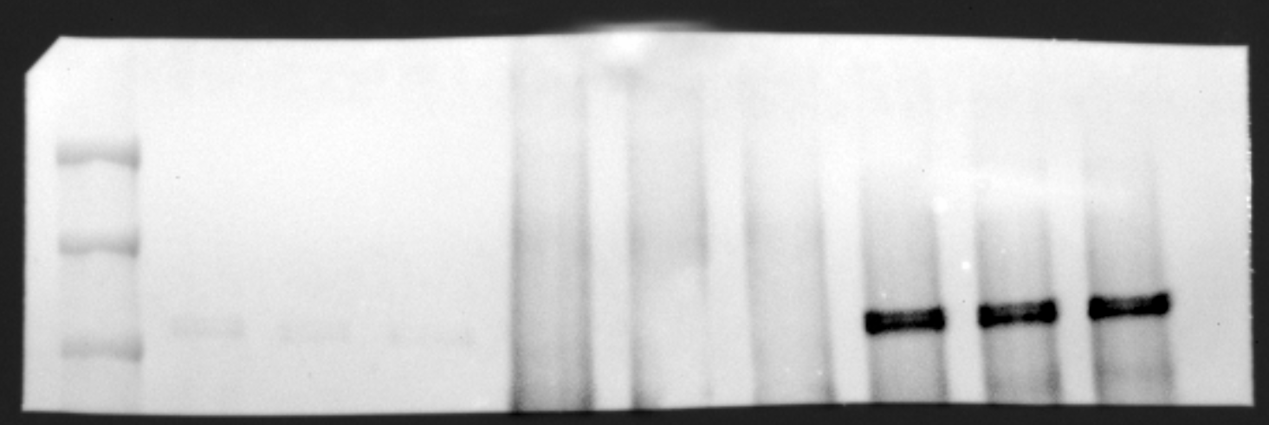
Replicate 1: LSD1

Slide 39
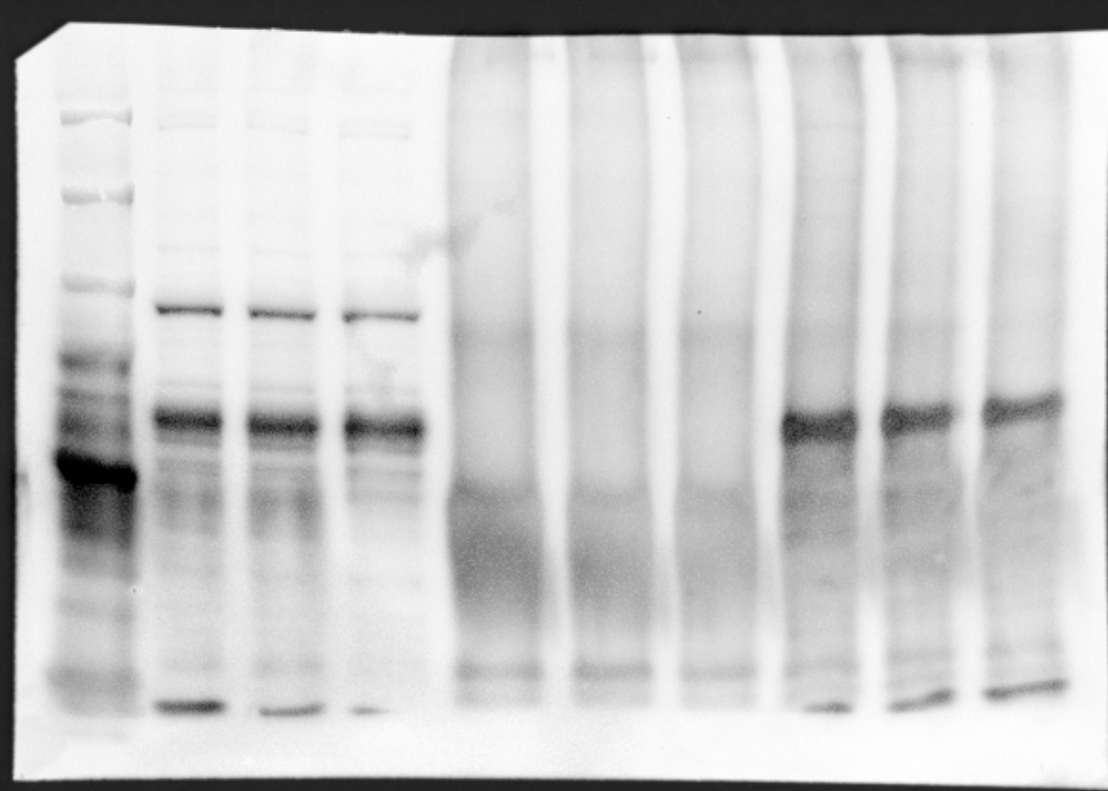
Replicate 1: RCOR1

Slide 40
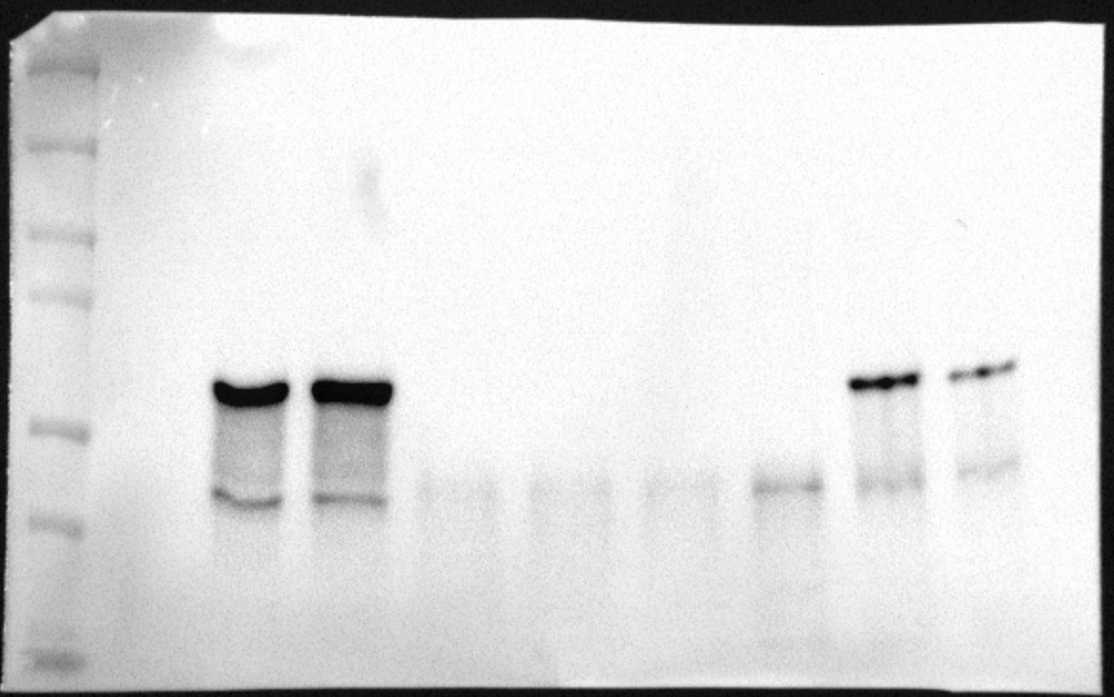
Replicate 1: V5

Slide 41
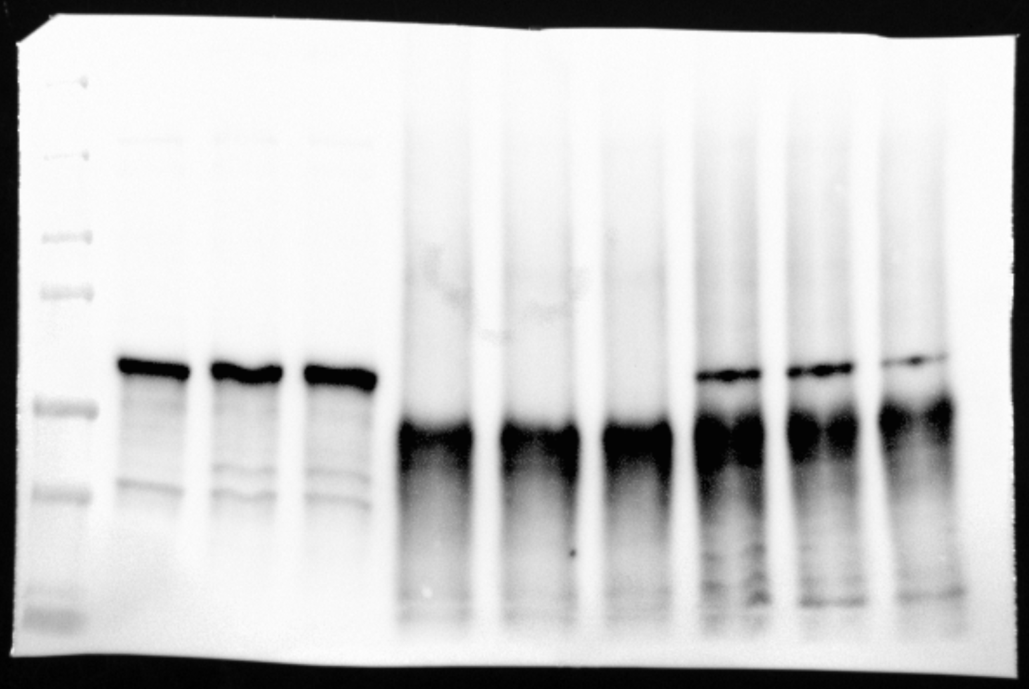
Replicate 1: U2AF2

Slide 42
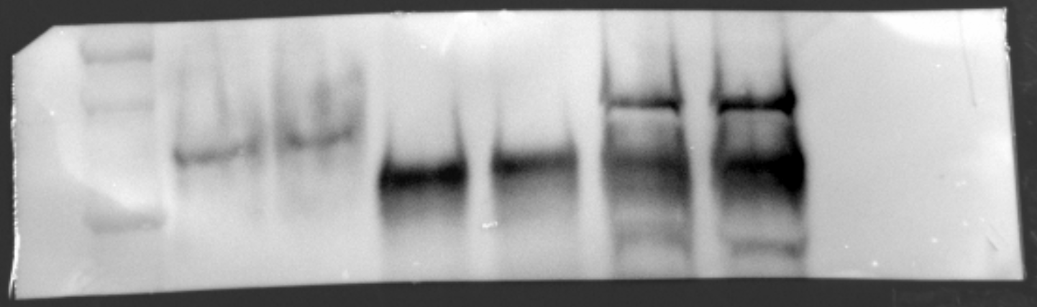
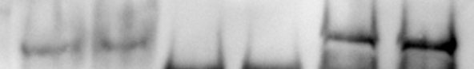
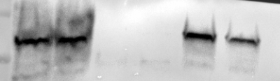
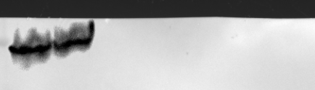
Replicate 2: RCOR1
U2AF2-V5 O/E SKMEL5
5% input
IgG-IP
RCOR1-IP
DMSO
Corin
DMSO
Corin
DMSO
Corin
Anti-RCOR1
Anti-V5 (U2AF2)
Anti-GAPDH
In this experiment, only U2AF2-V5 O/E SKMEL5 cells are used, excluding WT SKMEL5.

Slide 43
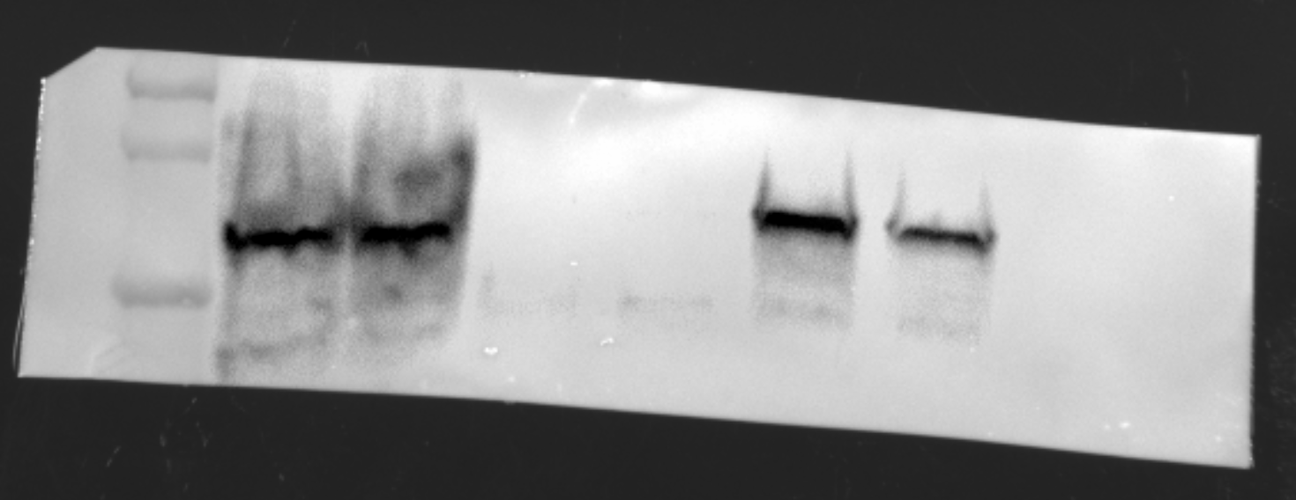
Replicate 2: V5
U2AF2-V5 O/E SKMEL5
5% input
IgG-IP
RCOR1-IP
DMSO
Corin
DMSO
Corin
DMSO
Corin
Anti-RCOR1
Anti-V5 (U2AF2)
Anti-GAPDH
In this experiment, only U2AF2-V5 O/E SKMEL5 cells are used, excluding WT SKMEL5.

Slide 44
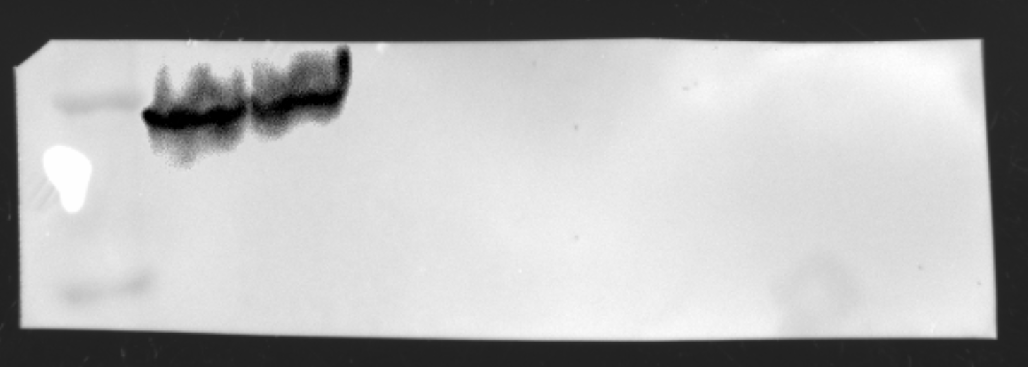
Replicate 2: GAPDH
U2AF2-V5 O/E SKMEL5
5% input
IgG-IP
RCOR1-IP
DMSO
Corin
DMSO
Corin
DMSO
Corin
Anti-RCOR1
Anti-V5 (U2AF2)
Anti-GAPDH
In this experiment, only U2AF2-V5 O/E SKMEL5 cells are used, excluding WT SKMEL5.

Slide 45
Figure 3F, Extended Figure 5C
Gels – SKMEL5 cell lines treated with DMSO, GSK-LSD1, MS275, GSK-LSD1 + MS275, or corin (24h, 2.5uM). PCR products for TJP1 exon 20, MYO1B exon 23, FN1 exon 33

Slide 46
Replicate 1&2: FN1
Rep1
Rep2

Slide 47
Replicate 3: FN1

Slide 48
Replicate 1&2: TJP1
Rep1
Rep2

Slide 49
Replicate 3: TJP1

Slide 50
Replicate 1&2: MYO1B
Rep1
Rep2

Slide 51
Replicate 3: MYO1B

